Slide 1
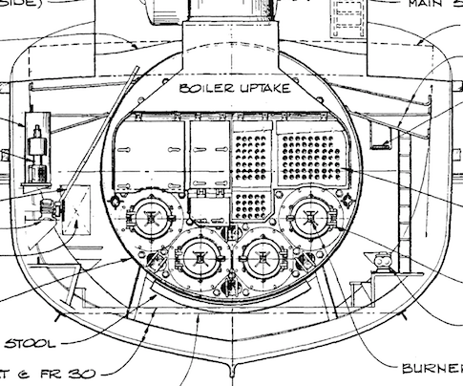
Notes:
Print & cut

Slide 2
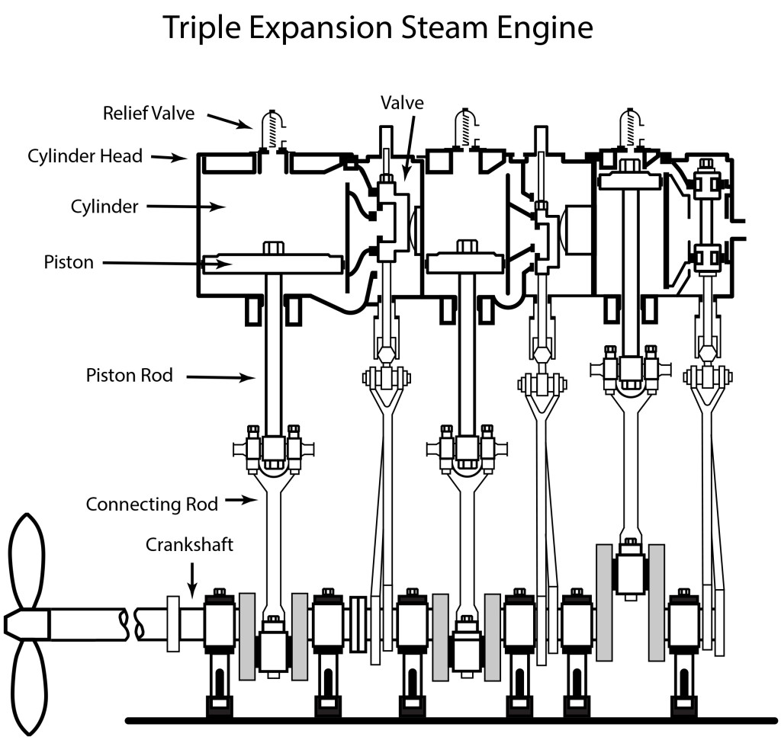
Notes:
Print & cut

Slide 3
Notes:
Print & cut

Slide 4
In the boiler room, oil and heat (in the form of a small fire) are combined to create a large fire.
In the boiler room, fire heats the water so that it becomes steam.
In the engine room, steam is transferred to the valve. It creates high pressure, so that valve gets pushed down.
In the engine room, the valve gets pushed down so steam can enter the cylinder. As steam increases, it creates a high pressure, so the pistons get pushed down.
In the engine room, when the pistons are pushed down, they spin the crankshaft.
When the crankshaft spins, the propellor on the side of the boat spins. The propeller pushes water so that the boat can move.
Notes:
Print & cut

Slide 5
Chemical Energy + Heat→ Heat Energy
Heat Energy + Water→ Mechanical Energy
Mechanical energy + Pressure→ Mechanical Energy
Mechanical energy + Pressure→ Mechanical Energy
Mechanical Energy
Mechanical Energy
Notes:
Print & cut

Slide 6
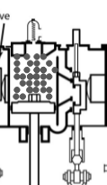
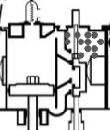
Notes:
Print & cut

Slide 7
🔥
🔥
🔥
Notes:
Print & cut

Slide 8
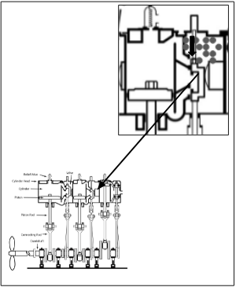
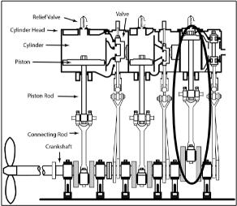
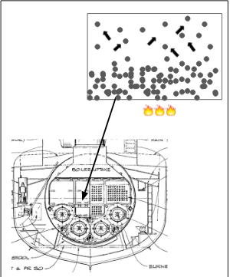
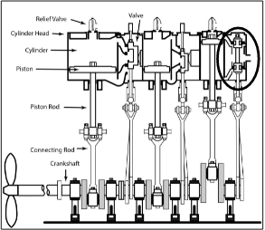
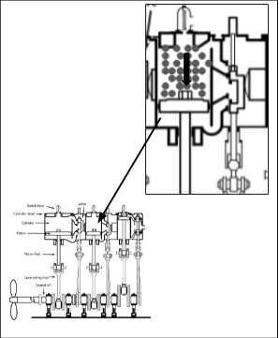
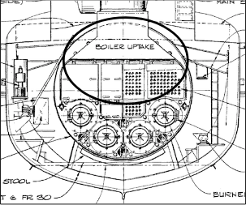
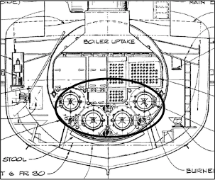
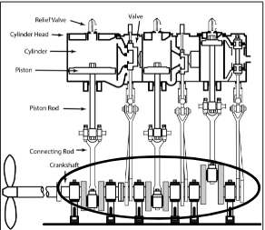
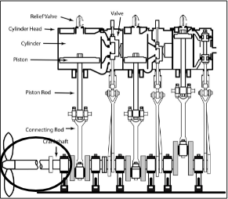
In the boiler room, oil and heat (in the form of a small fire) are combined to create a large fire.
Heat Energy + Water→ Mechanical Energy
In the engine room, steam is transferred to the valve. It creates high pressure, so that valve gets pushed down.
In the engine room, the valve gets pushed down so steam can enter the cylinder. As steam increases, it creates a high pressure, so the pistons get pushed down.
In the boiler room, fire heats the water so that it becomes steam.
Mechanical energy + Pressure→ Kinetic Energy
Mechanical energy + Pressure→ Mechanical Energy
Chemical Energy + Heat→ Heat Energy
In the engine room, when the pistons are pushed down, they spin the crankshaft.
When the crankshaft spins, the propellor on the side of the boat spins. The propeller pushes water so that the boat can move.
Mechanical Energy
Mechanical Energy
Notes:
Answer Key--move cards around to view complete answers!

